Slide 1
WindowDash
Brendan and Lucas

Slide 2
Team
Brendan Taylor
Lucas McColgan

Slide 3
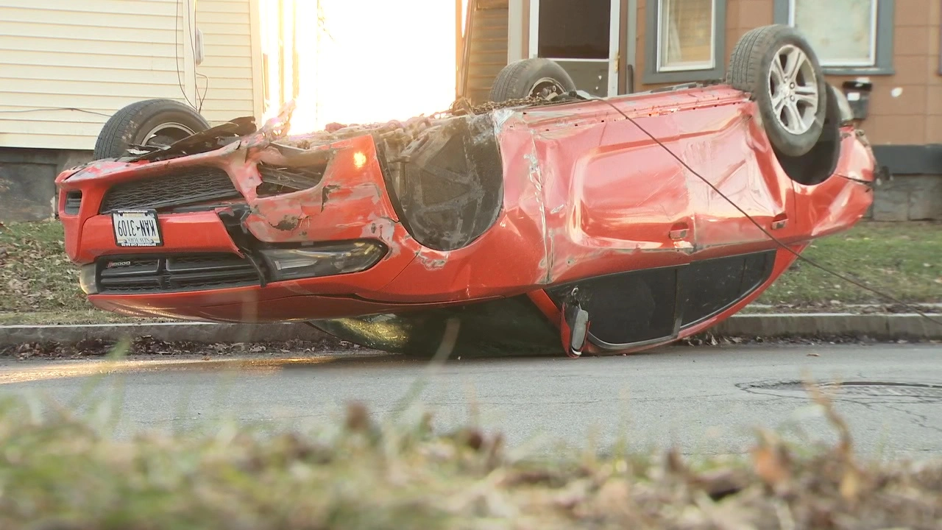

Problem
Doordash involves the usage of a driver, these drivers may not always be available, and are rather expensive as a car isn’t the most gas efficient vehicle to transfer packages. They may also not properly complete the delivery.

Slide 4
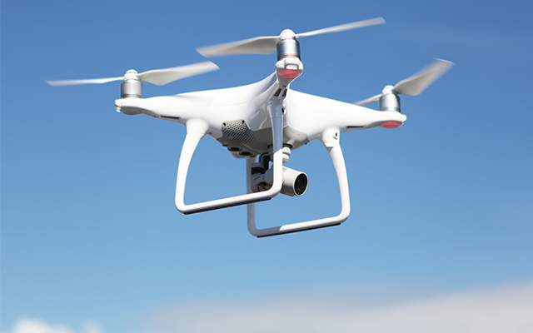

Solution
In our solution, we decided that replacing the driver and cars with automated drones would solve all of these issues. Drones are always available to be ordered from, are cheaper to operate for the customer, and don’t need to take the roads.

Slide 5
Demo

Slide 6
Lessons Learned
We learned that making a “website” map is a good idea for layout planning.
Assign a scope to the project to make sure it doesn't go outside of that scope (ie too many webpages).

Slide 7
Issues/Bugs Known
The only bug that we are currently aware of is when the server is first loaded it reports $NaN to the website and sends a error message. The way around this is to type http://localhost:3000/user/usertotal/0 into the web browser. This in return returns 0 to the website when http://localhost:3000/user/usertotal is access. There is currently a semi fix being use and hardcodes the solution.
It's not a bug but a time restraint issue some buttons go to a error webpage (A fake 404 page) but this is just a placeholder.
You can also buy a infinite amount of food with the buttons (not necessary a bug but something I would like to implement.

Slide 8
Future Versions
Multiple Deliveries at a time
An algorithm that determines price by distance

Slide 9
Thank you!
Any questions?

